Slide 1



Basic introduction to Survival Analysis with R
Dr. Susan Simmons, IAA

Slide 2
Survival Analysis workshop
Understand survival data
Censoring, survival probability, hazard rate
R Markdown
Create Kaplan-Meier curves (survival curves)
Stratify curves
Test curves
Brief intro to Cox regression models

Slide 3
What is survival Analysis?
In survival analysis, we are interested in the time until an event occurs, or failure time.
Event is a qualitative change that can be tied to a specific point in time.
Originally designed to study the occurrence of death in medical studies – hence survival analysis.
Other names:
Time-to-event analysis
Duration analysis
Failure time analysis
Reliability analysis

Slide 4
“Time-to-event data?
In survival analysis, “time” generally refers to tenure rather than actual calendar time.
In survival analysis, each observation will either have the event occur (death, customer leaves, customer buys a new product, machine breaks down, etc) OR it will be censored
We will focus on “right censored” data (but can also have left censored, or interval censored)
Right censored means we don’t know what happened to them after the time we have recorded for them
Different than Logistic regression…
Logistic regression: “Did it happen?”
Survival analysis: “How long did it take to happen?”

Slide 5
Data Structure
In survival analysis, the target variables is actually two pieces – one continuous and one categorical:
Time: the tenure for an observation (continuous)
Event/status: At the end of that time, what happened? (categorical)
Observation | Time (Tenure) | Status (censor)
1 | 82 | 0
2 | 76 | 1
3 | 84 | 1

Slide 6
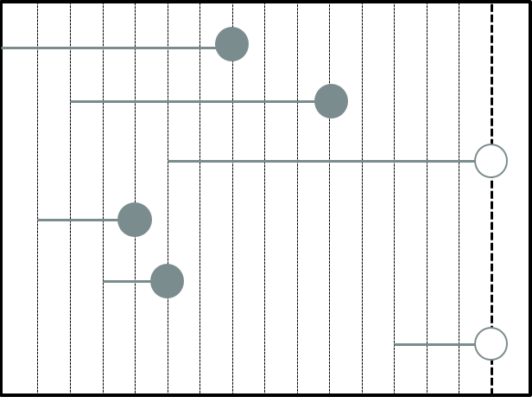
Tenure and Censoring
Observation
1
2
3
4
5
6
1
2
3
4
5
6
7
8
9
10
11
12
13
14
15
Time

Slide 7
Tenure and Censoring
Observation
1
2
3
Obs Tenure Censor
1 7 1
2 8 1
3 10 0
4 3 1
5 2 1
6 3 0
4
5
6
1
2
3
4
5
6
7
8
9
10
11
12
13
14
15
Time

Slide 8
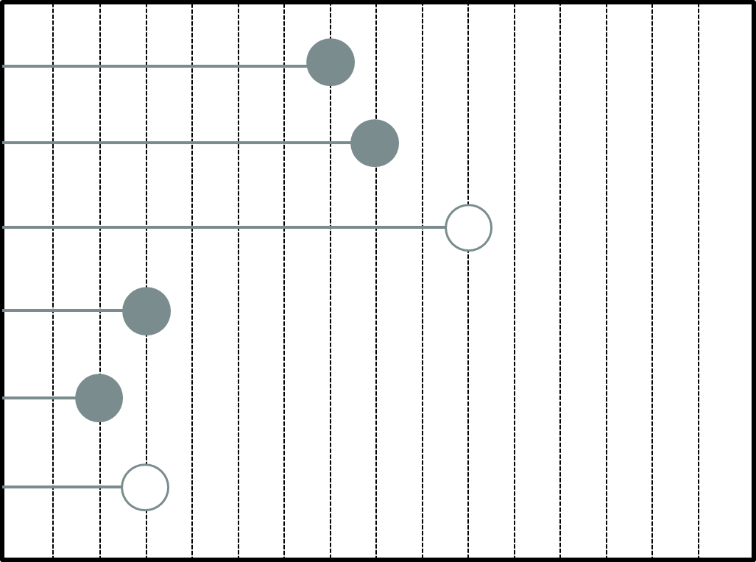
Interested in “tenure”
Obs Tenure Censor
1 7 1
2 8 1
3 10 0
4 3 1
5 2 1
6 3 0

Slide 9

Survival function
Survival function: probability of surviving beyond time t:
Properties:
Always starts at 1 (or 100%).
Never increases.
Bounded below by 0 (or 0%).
Most common method is the Kaplan-Meier curves
$$S\left(t\right)=P\left(T>t\right)$$

Slide 10
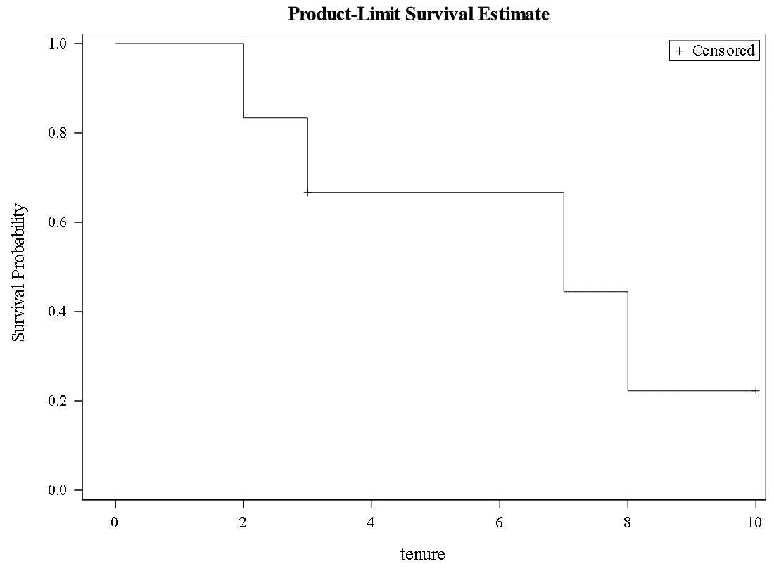
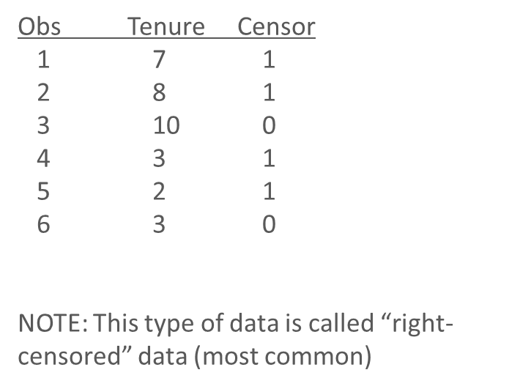
Small data set

Slide 11
Time to use r
You need to have R AND RStudio downloaded (R is the programming language and Rstudio is the IDE…integrated development environment)
In Rstudio, you will need to install the package survival and ggplot2
Command in R is install.packages(“survival”)
Step 3 Title
Step 2 Title
Step 1 Title

Slide 12
Data set
We will be using the lung data set in the R package of survival
This data set is a lung cancer survival data set from the North Central Cancer Treatment group (NCCTG). The performance scores rate how well the patients can perform usual daily activity.
The variables are:
Inst – institution code
Time – survival time in days
Status – censoring status: 1=censored and 2=death (the event)
Age - age in years
Sex - 1 is for male and 2 is for female
Ph.ecog – ECOG performance score: 0=asymptomatic, 1= symptomatic but completely ambulatory, 2= in bed <50% of the day, 3= in bed > 50% of the day but not bedbound, 4 = bedbound
ph.karno - Karnofsky performance score (bad=0-good=100) rated by physician
pat.karno - Karnofsky performance score as rated by patient
meal.cal - Calories consumed at meals
wt.loss - Weight loss in last six months (pounds)

Slide 13
Time to go to R…

Slide 14
resources
R resources:
https://adv-r.hadley.nz/
https://bookdown.org/rdpeng/rprogdatascience/
https://moderndive.com/
https://r-graphics.org/
Survival
https://www.tidyverse.org/blog/2021/11/survival-analysis-parsnip-adjacent/
https://cran.r-project.org/web/packages/survival/vignettes/survival.pdf
http://www.sthda.com/english/wiki/survival-analysis-basics

Slide 15

Thank you!

